Slide 1

Group 14

Slide 2





Our Team
Luyao Chen
Jinxuan Chen
Qingyang Wu
Yuchen Luo
Xiaotong Wang

Slide 3





Project
Recap
The Buy Now, Pay Later (BNPL) Firm has begun offering a new “Pay in 5 Installments” feature and is going to onboard 100 merchants every year.
This project focuses on these tasks:
Overview of consumer and transaction data
Analysis to find the 100 best merchants
Recommendations
Notes:
our project is here to make people winners。We are going to do that by providing BNPL with a way to choose top 100 merchants

Slide 4
Our Process
Website
&
Ranking System
Preliminary Analysis
Feature Engineering
Week 1
Week 2
Week 3
Week 4
Week 5
Week 6
Outlier Analysis
&
Geospatial Visualisation
Modelling
Result Analysis

Slide 5



Working Hours
Communication Tools
Feature Engineering
Preliminary Analysis
Result Analysis
190 hours
Website Construction
Meeting
Modelling & Ranking System
Fraud Analysis

Slide 6
Data Introduction

Slide 7

Security and Privacy
All data is stored on a
private GitHub repository
All devices used in this project
are privately secured
All data and code are confidential
Notes:
Before we introduce the data, our team would like to emphasis the security and privacy policies we followed:
All data is stored on a private GitHub repository.
All devices used in this project are privately secured.
All data and codes are confidential.

Slide 8
Data Introduction
4,026
Merchant dataset
499,999
Consumer dataset
14,195,505
Transaction dataset
34,978
Fraud dataset
Full Dataset
External Dataset
18,442
Postcodes dataset
2,288
Mean total income dataset
by SA2 Districts
Notes:
now let’s look at the datasets we used
First, the merchant, consumer and transaction datasets were merged into full dataset. We also transformed all the postcodes into SA2 codes with corresponding mean total income.
Page 9:

Slide 9
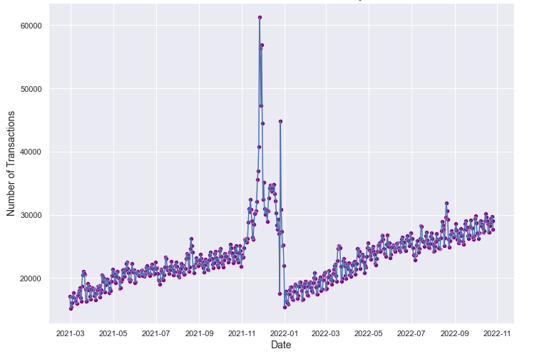
Visualization
Number of Transactions Per Day
Observation
Similar trend each year
High volume of transactions during Christmas and the Summer Holiday
Notes:
Now, let’s have a look at the trends of transaction volume.
The volume of transactions during Christmas and the Summer Holidays is higher compared to the rest of the year. Also, the yearly volume of transactions follows a similar trend. For example, （点一下）the trends from March to November in each year are similar. Our model will make an assumption based on these trends, which will be explained later.
Page 10:

Slide 10
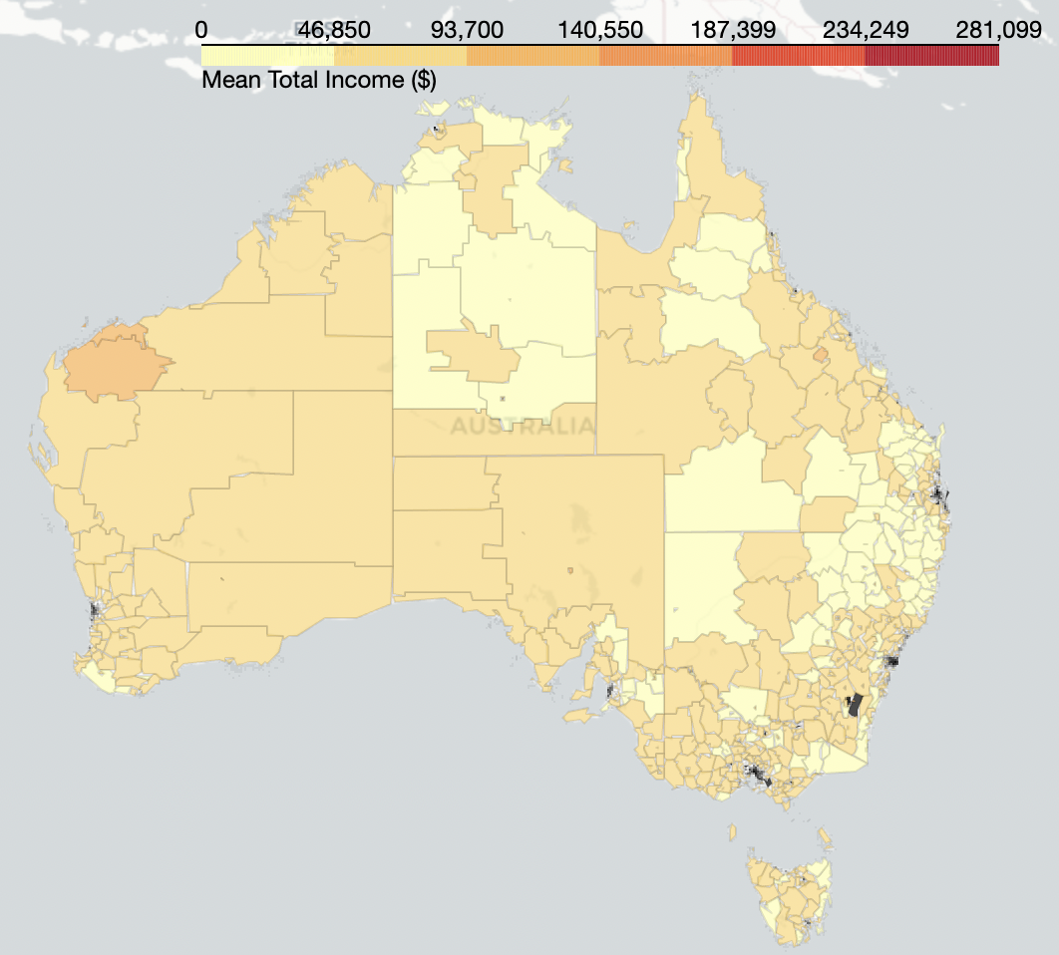
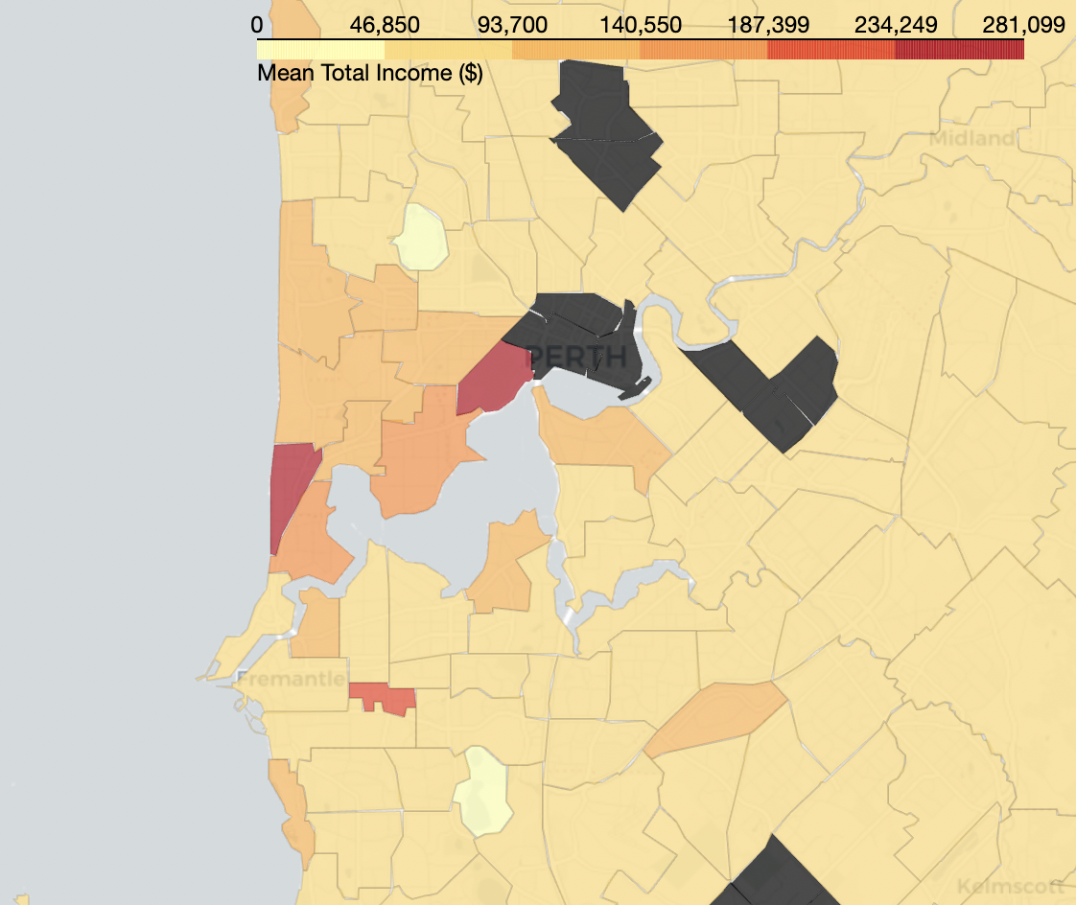
Visualization
Mean Total Income
Consumers around Perth have a relatively higher mean total income
Notes:
Now, let’s move to the map of mean total income by sa2 areas.
This map uses a color scale to show different mean total income levels. Our team replaced any missing values with their corresponding state mean total income. The only three areas（点一下） colored red in all of Australia are near Perth meaning that consumers here have relatively higher mean total income compared to the rest of Australia. Therefore, these areas may be more profitable for the BNPL company to target.
Page11:

Slide 11
Visualization
Number of Consumers in Each State
7,765
72,861
Northern Territory
Queensland
79,146
144,188
Western Australia
New South Wales
54,973
117,525
South Australia
Victoria
18,878
Tasmania
Notes:
Next, we have a diagram showing the number of consumers by state. As we can see, (点一下)NSW and Victoria have the most consumers. Hence, the company may earn more profits in these two states.

Slide 12
Analysis
Notes:
Eva will now explain how to find the 100 best merchants.

Slide 13
Assumptions
Limitations
Assumptions & Limitations
Transaction
Limited transaction data
Transactions follow similar pattern each year
Only data from 2021-02-28 to 2022-10-26
Fraud data
Transactions other than the days listed in the delta files for both customer and merchant have 1% fraud rate
Missing SA2 codes
2 postcodes out of 3167 postcodes do not have corresponding SA2 code
Notes:
Thank you. There are a few assumptions we made in this project and some difficulties we encountered.
We first assume that the transaction volume and customers’ consumption habits follow similar pattern each year. For instance, consumers would generally spend more during Christmas and New Year holidays.
Also, to obtain a realistic approach, we assume all transactions have at least 1% of chance to be fraud.
(slide 14)
One limitation of our project is that we only have transaction data, from February 2021 to October 2022.
In addition, we have 2 postcodes which cannot be matched to a SA2 District. Given the small number of missing values, data from these areas are simply ignored when plotting geospatial graphs.
(slide 15)

Slide 14
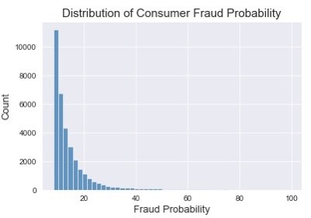
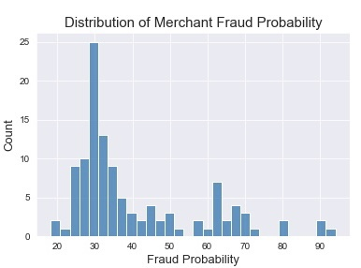
Fraud Detection
with logistic regression model
Utilize provided fraud datasets to predict whether a transaction is fraud
Remove fraud transactions and proceed to the next stage with the remaining data
Notes:
Based on this assumption, we then use the given fraud datasets to predict whether other transactions are fraud. After that, we discard all fraud transactions before feeding them to our ranking system.(回slide 13)

Slide 15
Ranking Factors
Historical data
Predictions for next period
Total number of consumers
Average transaction dollar value
Number of consumers
Total number of transactions
BNPL revenue
Mean income of consumers
Revenue level
Number of transactions
BNPL revenue
Number of distinct postcodes
Notes:
To select the best merchants to cooperate, we first summarize each merchant’s data into several characteristics, including their customer base, revenue, transaction volume and category etc. We then use merchants’ historical data to predict their future performance.
(slide 16)

Slide 16
Final Ranking Criteria
BNPL revenue
Total number of consumers
40%
Total number of transactions
30%
30%
Key factor: BNPL revenue = take rate × total transaction
Notes:
The main feature in our ranking system is the predicted revenue that the company could gain from the merchant. The other two attributes are consumer base and transaction volume since they are considered to be positively related with a merchant’s stability and long-term revenue.
Using these criteria, we found the top 100 merchants which will be discussed by Steven.

Slide 17
Result & Recommendation
Notes:
Thank you Eva.

Slide 18
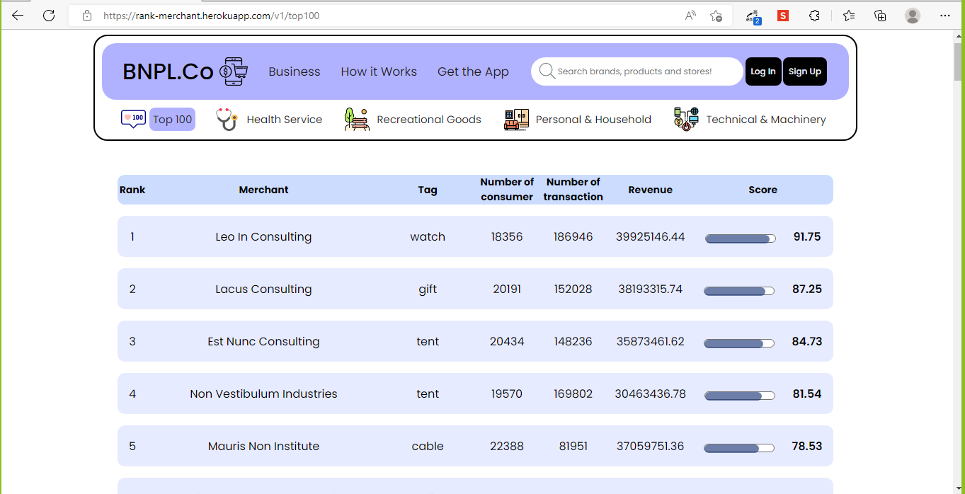
Result
https://rank-merchant.herokuapp.com/v1/top100
Notes:
To better display our final ranking and analysis, we designed this web page as a dashboard which can be added to the company’s main website. This main section shows the Top 100 Merchants. We classify all tags into four segments and we give one section to display Top 10 Merchants in each segment. For each merchant on the board, we display their predicted business features in the future and if we click into a certain merchant, we have the trend of, for example the revenue we took from them over the past.
Pg 19:

Slide 19
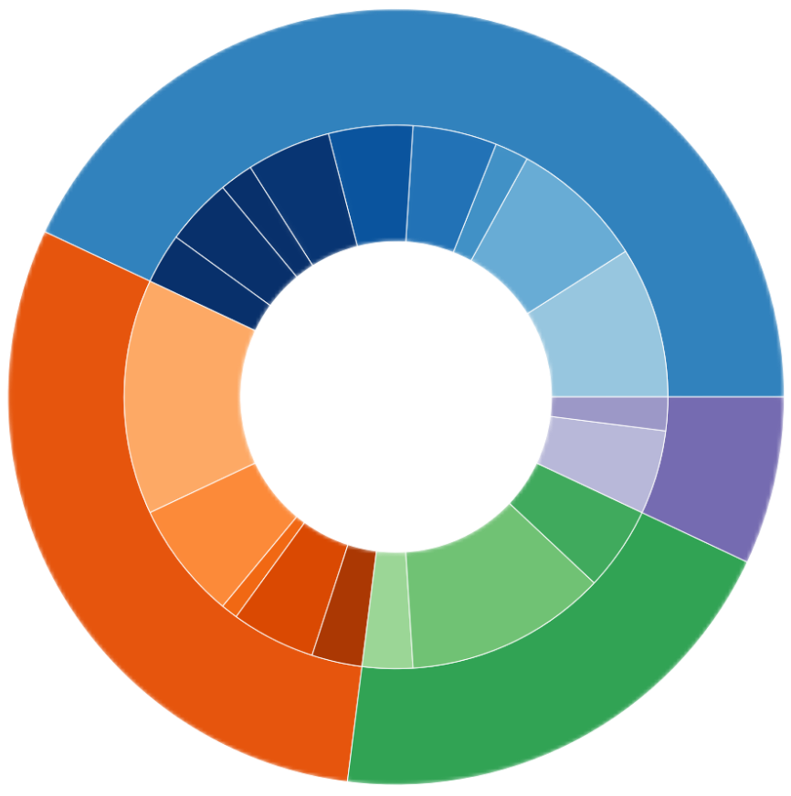
Insights
Personal & Household (43%)
Best Segment
gift (8)
Personal & Household
covers the most individual tags
purchases are more frequent and sustainable in long-term
watch (9)
tent (14)
Best Tags
Tent
Health
Services (7%)
larger amount of consumers and transactions
digital goods (7)
Computer
computer (12)
higher average revenue
Recreational (30%)
Technical & Machinery (20%)
Notes:
Within the Top 100 merchants, the segment of Personal and Household retail is the largest at 43%, potentially because it covers the most individual tags and merchants. Alternatively, it could be that, for individual consumers, the purchase of personal and household goods are always more frequent and sustainable in the long-term. Therefore these merchants are more likely to run a risk-less business as the demand is always large. For the individual tags, the top two that take up the most weights are ‘tent’ and ‘computer’, 14 and 12 out of 100 respectively. This may be because tent merchants often have high customer volume and flow while computer merchants are related to greater transaction values.
Pg 20:

Slide 20
Recommendation
Personal & Household (43%)
gift (8)
Investment in the Personal & Household
retailers to receive risk-less benefits
watch (9)
tent (14)
Health
Services (7%)
digital goods (7)
computer (12)
Recreational (30%)
Technical & Machinery (20%)
Notes:
As such, we recommend that this top ranking be used as an indicator for investment of the BNPL company. The final ranking could be considered as an insight into and assessment of whether a particular business behaviour is likely to lead to large revenues and benefits and in turn, future business opportunities.
Pg 21:

Slide 21
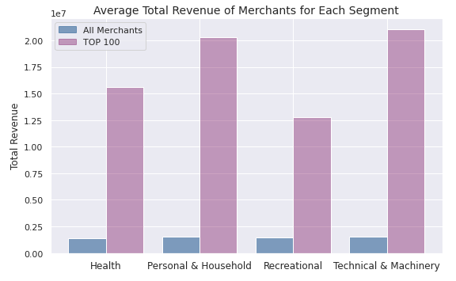
Insights
10 times
higher average revenue
Notes:
Furthermore, by comparing the average total revenue of the TOP 100 merchants with that of all other merchants, we see that the BNPL company’s profits can be more than ten times higher if they focus their resources on cooperating with the top merchants. Consequently, our final result is reliable in detecting what merchants are more likely to bring high return in each segment.
Pg 22:

Slide 22
Recommendation
Adopt a similar ranking system based on predictions of merchants’ future business prospects
Notes:
Therefore we strongly recommend the company to construct a similar system which consists of both predictions of merchants’ future business prospects and a ranking system based on that. This allows the company to pool all resources to maximize benefits.
Pg 23:

Slide 23
Recommendation
Target on Perth, NSW and VIC
Notes:
Also, based on our previous geospatial analysis, we recommend the company to focus on merchants and businesses in Perth, NSW, VIC as these regions relate to the highest income and number of consumers.
翻页

Slide 24
Reflection
Notes:
Now I’ll hand it to Xiaotong for the last part of our presentation.

Slide 25
Business Benefits
Consumer
Pay over 5 installments without interest
Merchant
Boost their
customer base
BNPL Company
Gain revenue from merchants
Notes:
By developing this ranking system, we can actually achieve not just a win-win situation, but rather a win(点一下), win(点一下) and win(点一下) situation.
Consumers win(点一下), their shopping desire gets fulfilled instantaneously, with as many as 5 instalments but 0 interest.
Those merchants in the rank win(点一下), their full potential has been realised, and their customer base gets boosted.
BNPL wins(点一下), by optimising the potential partner list and gaining revenue from them.

Slide 26

Reflection
Hardware
Time management
Dataset limitation
......

Slide 27
Reflection
Hardware
Time management
Dataset limitation
......
Notes:
In this project(点一下), we faced some difficulties.
(点一下)By manipulating millions of transaction data，we faced the challenge of limited computing resources.
(点一下)Therefore, we spent more time building and running our code, we faced the challenge of limited time.
(点一下)And we only managed to get one year of data, which may present a year's pattern, but we cannot see it in the long term.
(点一下 省略号跑出来)If we could address these issues, we could have build better models and receive more accurate results.

Slide 28

We create an economy where everyone wins!
Is this project worth pursuing?
Yes!!!
Notes:
After going through all the difficulties,(点一下) you may ask: is this project really worth pursuing?
Our answer is: (点一下)Yes! (点一下)because we create an economy where everyone wins!

Slide 29
Thank you!

